Slide 1
Implementation
Database In
AL-HIDA Drug Store
Alfi Naufal
Hilman Maulana Anhar
M Dani Setiawan
1SC8

Slide 2
INTRODUCTION
AL-HIDA is taken from our name Alfi, Hilman, and Dani. A Drug Store that uses a database which is useful to make it easier for Customer to purchases medicines and make a transaction in an application.

Slide 3
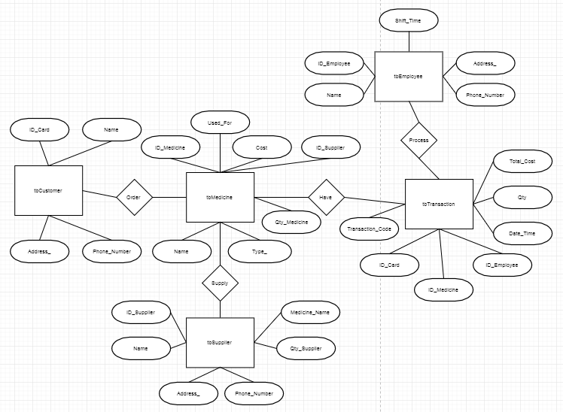
ER Diagram

Slide 4
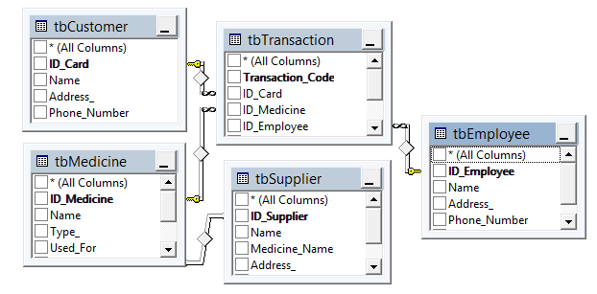
Scheme

Slide 5
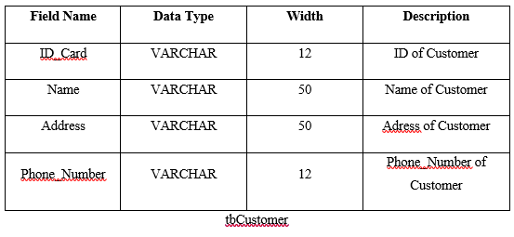
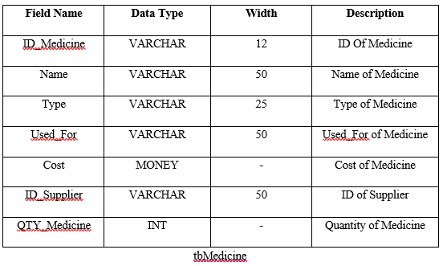
Table Design

Slide 6
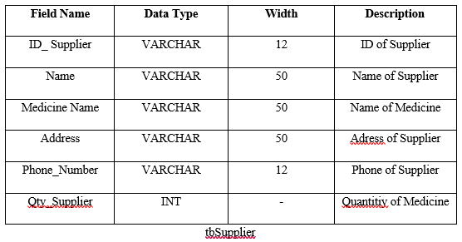
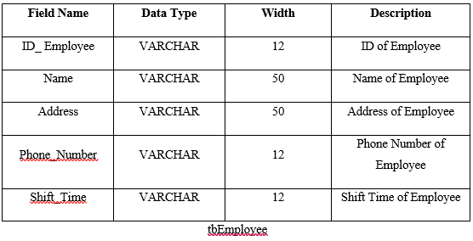
Table Design

Slide 7
Table Design

Slide 8
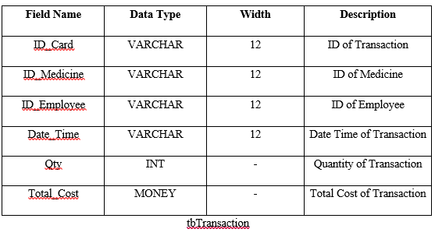
Table Design

Slide 9
Querying Demo

Slide 10
THANK YOU ☺
ANY QUESTIONS?

